Slide 1
183 YEARS OF RAILWAYS IN YORK
Frank Paterson
General Manager,
Eastern Region, British Rail
1978 -1985
Notes:
No academic -no historian - no techy! So apologies in advance for the quality of some of the material
Fascinated by the origins ,range and scale of developments and huge admiration for my predecessors.
Hopefully by the end you will understand and share some of my enthusiasm

Slide 2
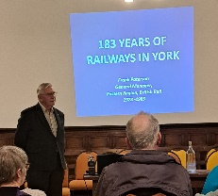
This slideshow is based on a talk given by Frank Paterson to the York Civic Trust in October 2023. Frank was General Manager of the North Eastern Region of British Rail from 1978 to 1986 and is now President of the Friends of the National Rail Museum.

Slide 3
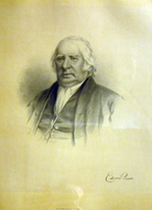
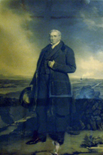
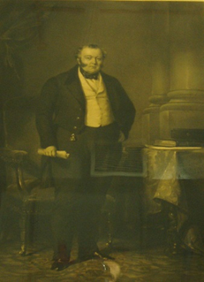
Founding Fathers of the Railways
Edward Pearse
George Stephenson
George Hudson

Slide 4

Edward Pease
Edward Pease owned a Woollen Mill in Darlington. He was a visionary seeing the potential of rail travel from the very start. He became a Director of the Stockton & Darlington Railway and a founding Director of the Stephenson Locomotive Company
He introduced George Stephenson to George Hudson and became a Director of the Great North of England Railway connecting Darlington to Newcastle & York then Newcastle to Berwick
He was particularly skilled at surveying routes and in 1825, with George Stephenson, created the world’s first passenger line from Stockton to Darlington.

Slide 5

George Stephenson
George Stephenson is known as the father of steam railways – He was responsible for -
The Rainhill Rocket trials in 1829
The first intercity railway in 1830 from Manchester to Liverpool
The North Yorks Moors Whitby to Pickering horse drawn railway
In 1835 he surveyed for Hudson the York & North Midland extension Scarborough.
His son Robert supervised the construction

Slide 6

George Hudson
George Hudson , another visionary, was Chairman of the York & North Midland Railway from 1836 to 1849
Later known as the Railway King, he financially controlled over 33% of all UK railways built between 1840 and 1849

Slide 7
The Railways arrive in York
On 29th May 1839 a temporary platform was constructed outside the city walls for the Yorkshire and North Midlands passenger train on a link from the Leeds to Selby line via Altofts Junction near Gascoine Wood .
Euston Station in London could now be reached via Normanton, Sheffield, Derby and Birmingham in 10 hours

Slide 8
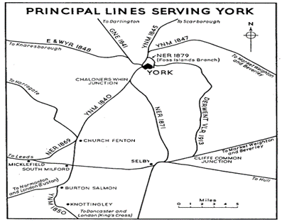
Principal Lines Serving York
This is a map of the principal Lines serving York by 1879. The first, key, routes are the Great North Eastern going North to Newcastle and the York and North Midland heading south to Derby. Both terminated at York and any long-distance journey required numerous changes between different company lines.

Slide 9
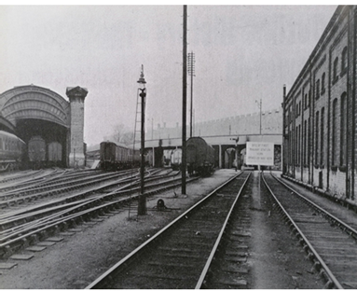
Breaching the Walls
The GNE and YNM shared line ran through the first arch built through York’s historic walls into a new station. This required an Act of Parliament, demonstrating the power of the railway lobby

Slide 10
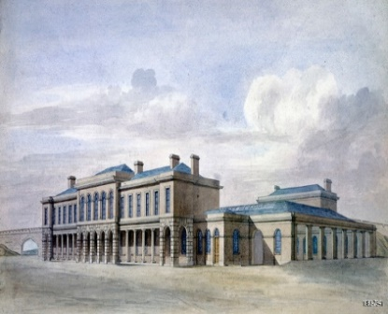
The Old Station 1841
Architect G. T. Andrews
The station was built inside the walls, contrary to Stephenson’s advice 4th January first Y&NM train to London
30th March first GNE train to Darlington
Notes:
Original joint Y&NM and GNE station - GT Andrews architect - influence on York buildings
4th January 1841 first Y&NM train to London - 30th March GNE Darlington

Slide 11
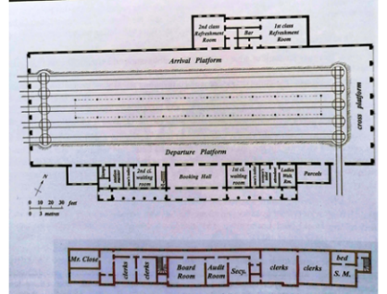
The Old Station
-There were two platforms with four lines and engine release turntables as trains went out the same way they came in.
- Note the 1st and 2nd class waiting rooms
- The top floor contained Y&NM board room, and an office for Mr Close , the Company Secretary
Notes:
Operation of joint trainshed– two platforms four lines - engine release turntables
cross platform open collonades - roof trusses Robt Stephenson Euston
1st and 2nd class refreshment rooms – 1927 museum
Top floor Y&NM board room – Mr Close –Company Secretary

Slide 12
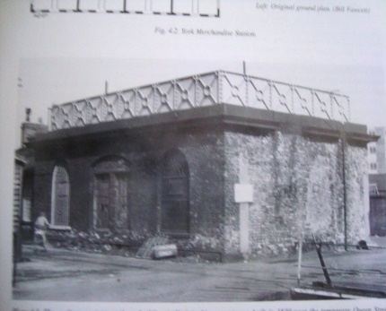
Still standing, this water tank was built in1839 adjacent to original YNMR locomotive round house

Slide 13
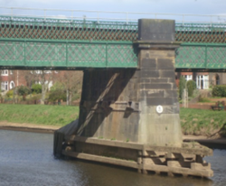
Scarborough Bridge
The first train to Scarborough ran on 7th July 1845 –with branches to Market Weighton in 1847 and Beverley in 1865. The bridge support design was based on one in Chester which then failed so metal ties were added. These can still be seen though the bridge itself was replaced in 1874.

Slide 14
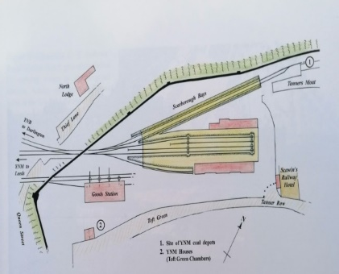
The Old Station 1845
The YNB was the York Newcastle and Berwick Railway . The YNM was the York and North Midland Railway

Slide 15
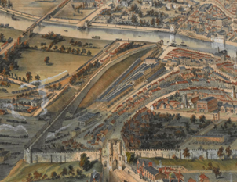
York Railways before 1860
This drawing by Nathaniel Whittock was created before the construction of Lendal Bridge in 1863. It shows the Scarborough Bridge, the Old Station with the Scarborough platforms and the Station Hotel, built in 1853. The marshalling yards and the coal drop at North Street lie outside the walls.

Slide 16
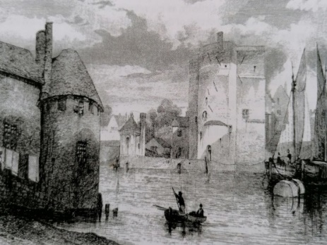
Barkers Tower before the Lendal Bridge
Note the ferry, and the water pumping station across across the river.
Notes:
Barkers tower – end of city walls – Ferry -Lendal Bridge 1863

Slide 17
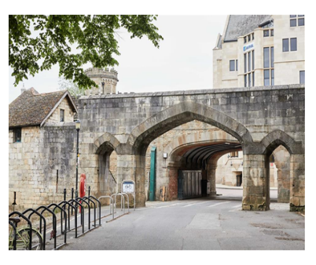
The Postern by Barkers Tower on North Street
Designed by G T Andrews in 1840 to allow passage of coal from the GNE depot to industries along the River Ouse. GNE Board decision 7th April, approved by City Surveyor 5th May. Contract agreed 6th June !
Notes:
North Street Postern – GT Andrews 1840 – Second breach of city walls for railways – shorter access to city from GNE coal depot.
Speed of developments
GNE Board decisions 1840 7th April – GTA to agree route with City Surveyor - 5th May approve design - 6th June Agree contracts.

Slide 18
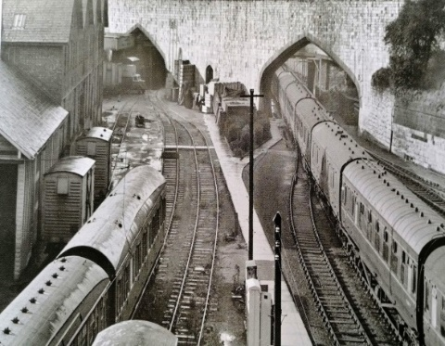
The Sack Wharehouse
A third arch breached the walls in1878 to allow freight in to the “Sack Warehouse”. Sacks were hired out to farmers for their produce
Notes:
1845 The freight arch – the third breach of the walls 1878 new freight depot
Sack Warehouse

Slide 19
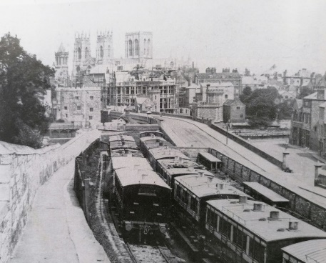
Lendal Bridge and the Scarborough Platforms
Lendal Bridge opened in 1863 and the platforms forthe Scarborough line were located just inside the walls
Notes:
1880’s - Scarborough lines looking North - Lendall bridge opened 1863
Yorkshire Club being built - note carriage lights

Slide 20
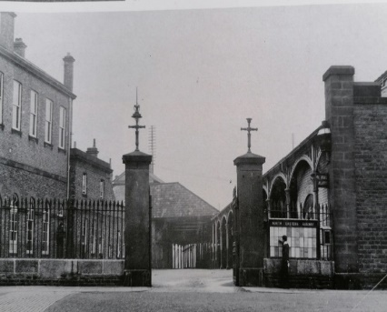
The Entrance to the Scarborough Platforms
Now the location of the War Memorial but these pillars were originally located at the junction of Lendal Bridge and Rougier Street
Notes:
1890’s Scarborough platforms – now site of war memorial
1st Class refreshment rooms
Left original Restaurant and railway museum – cab road roof in centre.

Slide 21
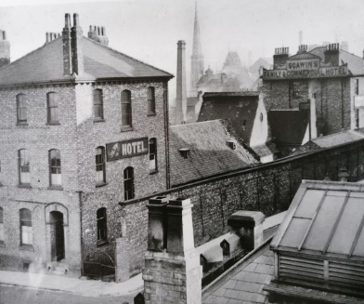
Hotels
In 1906 this site became the new Headquarters of the NER Railway
Now a rather grander Hotel
Notes:
Looking north from Scarborough platform entrance (war memorial) to site of 1906 NER HQ

Slide 22
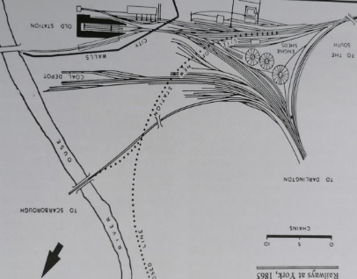
York’s Railway Network in 1865
Increasing traffic created congestion outside the walls and it was decided to re-route the line and build a new station outside the walls. The proposed route is shown by the dotted line. New bridges were needed at Leeman Road and Holgate Road.
Note the roundhouse engine sheds.
Notes:
1865 - Operating bottlenecks need for station outside the walls
Line of new railway – Holgate 7 Leaman Road bridges
Note roundhouse engine sheds – now site of Network Rail IECC

Slide 23
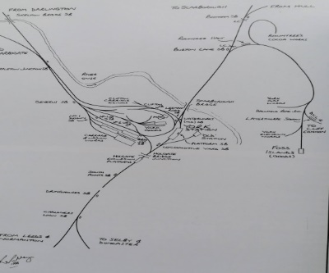
York’s Railway Network after 1877
The new station and main line routing, the Harrogate line, Challoners Whin and the Scarborough line with the Foss Islands line linking to the Derwent Valley Light Railway

Slide 24
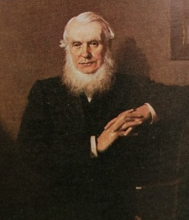
Henry Tennant
Henry Tennant was the Company Accountant of the North Eastern Railway from 1854 to 1871. He rose to General Manager from 1871 to 1891. He was responsible for relocating the station outside the city walls
Notes:
Henry Tennant, NER General Manager ,1871 -1891
NER Accountant 1854 -1871
Rebuilt Scarborough Bridge 1874 - New station 1877 - Freight depot 1877 – New Station Hotel 1878 – YRI 1889
Quaker – Education Reform – Temperance – Trade Unions
NER Director 1891-1910

Slide 25
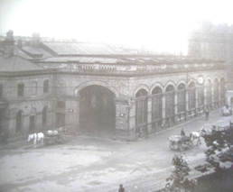
New Station Portico 1877
The carriage entrance designed initially by Thomas Prosser and from 1874 then William Bell, the North East Railway Architects
Notes:
New Station 1877 –Thomas Prosser NER Architect and William Bell who succeeded him in 1874
Portico carriage way

Slide 26
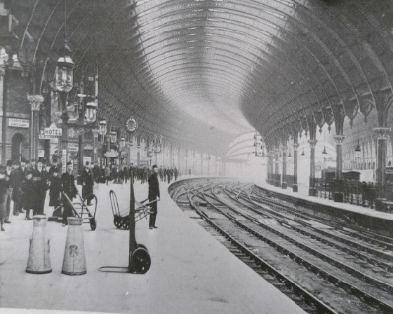
The New Station 1877
When built in 1877 York’s new train-shed with its unique glazed roof, was the largest station in the world– originally with 13 platforms joined by underpasses. The footbridge was added in 1900 together with the additional platforms outside the train-shed . In 1909 the platforms were extended and in 1938 island platforms added.

Slide 27
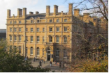
The Station Hotel 1878
Architect William Peachey designed the hotel with Scarborough brick and Tadcaster Stone. It had banqueting rooms and suites and 100 bedrooms with a further 27 added in 1900
Notes:
1878 Station Hotel – Architect William Peachey
Scarborough Brick & Tadcaster Stone – Banquetting rooms - suites - 100 bedrooms - 27 added 1900

Slide 28
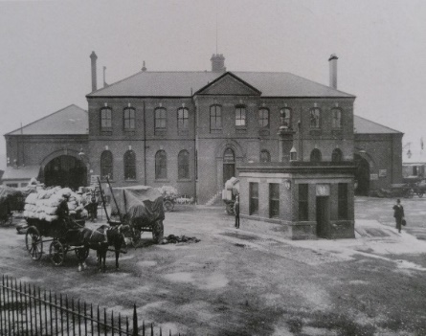
Goods Depot 1878
The Goods Depot incorporated a weighbridge and stables
Notes:
1878 Goods depot – weighbridge - stables

Slide 29
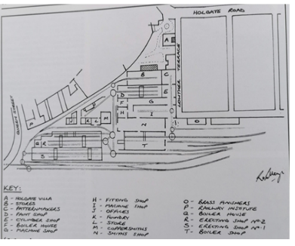
Engineering Works 1842 - 1905
In 1877 Henry Tennant bought the Railway Tavern and turned it into the (teetotal) Railway Institute. The Holgate Wagon Works occupied 17 acres with 4.5 acres of buildings operated from1867 to 1965
Notes:
Engineering Works between Queen Street and Holgate Road 1842 -1905 – museum 1928-75 - YRI 1877
Wagon Works Holgate 1867 - 1965 17 acres – 4.5 acres buildings
Carriage Works 1884 – 1992 – 45 acres -13 acres buildings

Slide 30
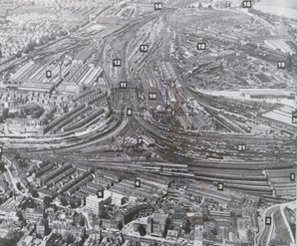
York’ Railway Infrastructure mid-1950s
1. South end York Station
2. Queen Street
3 . Erecting shops
4. Y&NM Loco works
5. Holgate Villa Offices
6. Holgate Bridge
7. York South Loco sheds
9. Carriage Works
10, Wagon works
18. Civil Engineers
19. Coaling plant
20. Goods Yard
(NRM Station Hall)

Slide 31
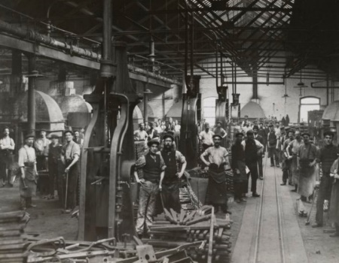
Locomotive Workshops
Steam Hammers
Notes:
Loco workshop. Steam hammers

Slide 32
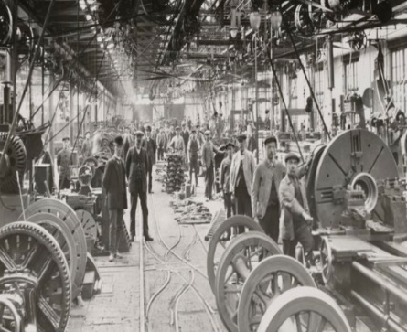
The Wheel Shop
Railway York’s biggest employer
Notes:
Railways York’s biggest employer ,1901 - 7000
The wheel shop

Slide 33
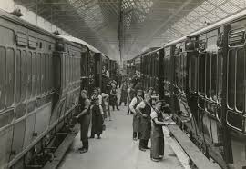
Teak Carriage Construction Works
Notes:
Teak carriage construction

Slide 34
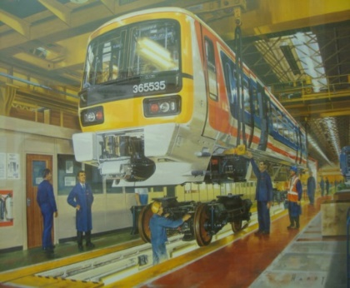
BREL’s Last Build
The carriage works was privatised and this was BREL’s last build before closure in 2002. A new assembly line but within the old building
Notes:
BREL Privatisation - The last build before closure in 2002

Slide 35
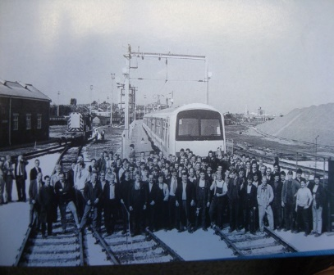
Redundant
Notes:
Closed 2002 - 290 redundancies
1902 – over 3000 jobs.

Slide 36
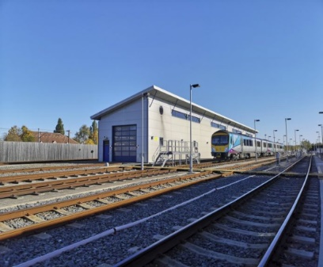
York’s Railway Infrastructure 2023
Siemens Trans-Pennine Rolling Stock Maintenance Depot, Clifton Sidings
Notes:
Siemens - Trans Pennine Rolling Stock Maintenance Depot, Clifton Sidings

Slide 37
Signalling

Slide 38
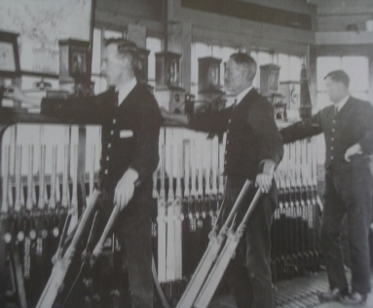
The Waterworks Signal Box
These long arm levers were later replaced
Notes:
Waterworks Signal Box

Slide 39
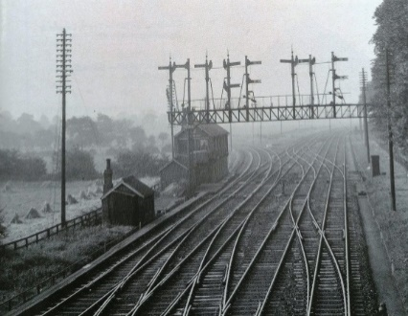
Challoners Whin
Made redundant by the Selby Diversion in 1983. The land to the left now hosts Tescos and the Askham Bar Park and Ride
Notes:
Chaloners Whin Junction –closed Selby diversion 1983 - now Tesco supermarket

Slide 40
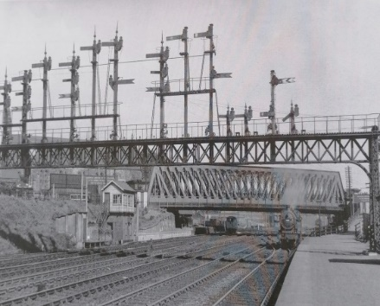
Holgate Bridge
Holgate Bridge was built in the 1860s to accommodate additional tracks. The platform on the right, for Knavesmire race-goers, was demolished in 1964
Notes:
Holgate Bridge – 1860’s Racecourse excursion platforms demolished 1964

Slide 41
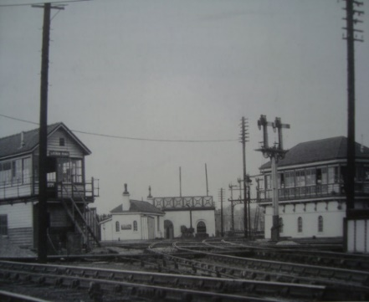
Scarborough Branch Junction
The locomotive water pump and signal boxes were demolished in 1974
Notes:
Scarborough branch junction –locomotive water pumping buildings & signal boxes demolished 1974

Slide 42
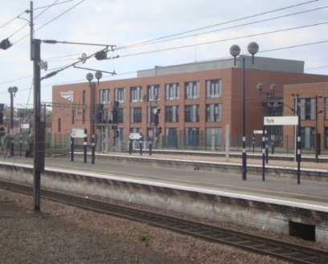
Network Rail’s Integrated Electronic Control Centre
The IECC provides the entire signalling function for the East Coast Main Line using TRUST Train Running System and ATR Automatic Train Reporting
Notes:
Network Rail IECC _ Integrated Electronic Control Centre for ECML
TRUST – Train Running System / ATR Automatic train Reporting

Slide 43
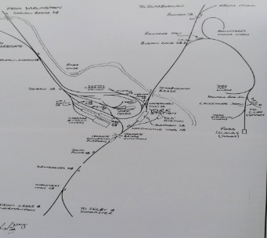
The Foss Island Branch
The Foss Islands Branch linked the Scarborough line with the Rowntree factory, the power stations along the Foss, the Barbican Cattle Market at Fishergate and the Derwent Valley Light Railway
Notes:
Elaborate on layout of Foss Islands Branch. - 1880 Freight & Coal Depot Walmgate Bar

Slide 44
Rownrees staff train

Slide 45
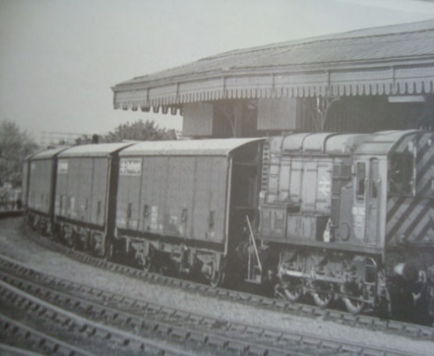
Rowntrees Factory Siding
Rowntree Factory in1970s. 50% of output was distributed by rail

Slide 46
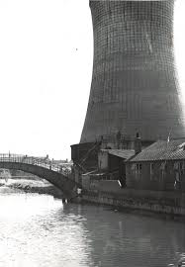
Power Station Cooling Tower near the River Foss
The cooling tower has been demolished but the bridge remains
Notes:
Electric power station on the river Foss – bridge remains

Slide 47
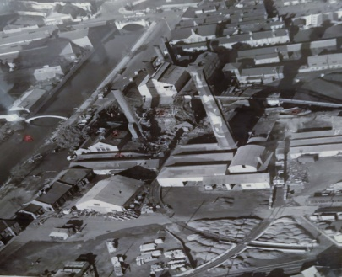
Foss Island Retail Park - before
The chimney and bridge both remain
Notes:
Gas works and York Electricity Power Station – Foss Islands Branch
Chimney and steel bridge remain

Slide 48
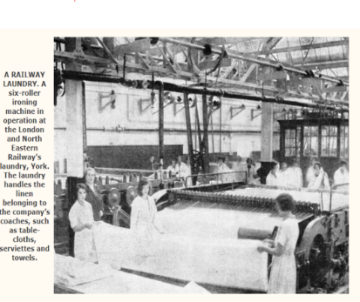
The Railway Laundry
Notes:
Hotels – tea rooms –restaurant cars - sleeping cars

Slide 49
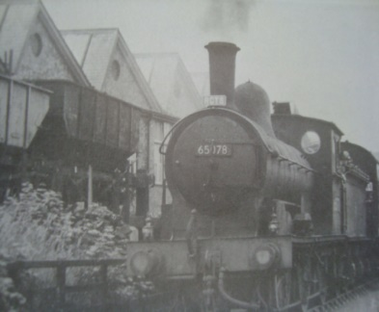
The NER Railway Laundry – the coal drop
Notes:
NER Laundry coal drop

Slide 50
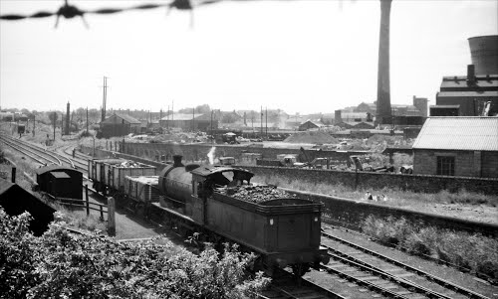
The Foss Islands Branch Line
The chimney and cooling tower visible on the right
Notes:
Private sidings - now Layerthorpe business and retail park – Morrisons
Redfern Glass – coal -sand -lime closed 1984

Slide 51
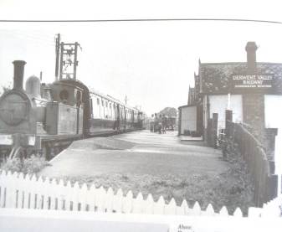
The Derwent Valley Light Railway
Running from Selby to Layerthorpe was opened in 1913. The 3 passenger trains round trips daily ceased in 1926 except for Saturday steam trips 1977/78. Its main purpose was freight transport from villages on the route
- coal, barley, lime, potatoes, sugar beet and chicory. Closed
More information on their website
Notes:
Derwent Valley Light Railway - Selby to Layerthorpe 1913 – 3 passenger trains round trips daily – ceased 1926 – Saturday steam trips 1977/78
Freight coal –oil- barley- lime – potatoes- sugar beet. Closed

Slide 52
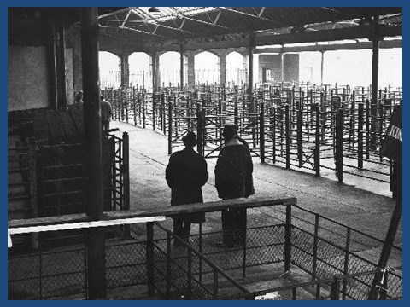
York Cattle Market
Closed 1976
Notes:
Barbican livestock market – Walmgate Bar

Slide 53
PERSONAL HIGHLIGHTS 1978 - 1986
High Speed Train-HST Inter City 125
SELBY DIVERSION
East Coast Main Line Electrification

Slide 54
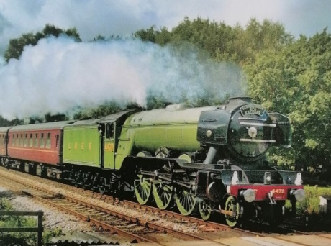
London and North Eastern Railway
Flying Scotsman 1923
Notes:
LNER 1923 – Flying Scotsman

Slide 55
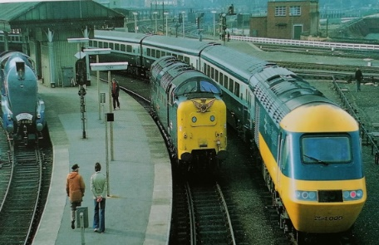
40 Years of LNER Traction at York 1980
1938 - A4 Pacific Mallard - holder of the world steam record
1962 - English Electric Deltic – expresses
1978 – BR Derby designed & built Inter City 125 - 1985 diesel world record 147mph. Newcastle to Kings Cross non stop 264 miles in 2h19m37s an average of 122mph

Slide 56
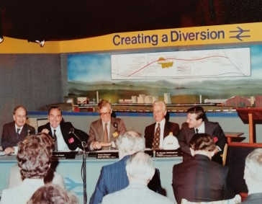
The Selby Diversion Launch Event 1980
F: our Chairmen : Sir Derek Ezra National Coal Board, Sir Peter Parker British Rail, Glyn England the Central Electricity Generating Board and Mr Wittingham Monks the contractors
For more on the Selby Diversion see Hugh Fenwicks account and other details on www.railwaytogreenway.org
Notes:
1980 Selby Diversion launch
Ezra NCB- Parker BR- England CEGB- Whittingham - Monks

Slide 57

East Coast Main Line Electrification 1985- 1991
The project cost £306million and took 7 years – It was delivered on time and within budget. It took 33,000 masts, 1400 miles of electric cable, 400 miles optic cables, 62 locomotives and 324 coaches

Slide 58

Notes:
Railways continuous and lasting long term contribution to the future prosperity of York
Recycle RAILWAY LAND

